Slide 1
Cookbook for Practice 2.4
实践2.4攻略
Cong Li 李聪

Slide 2

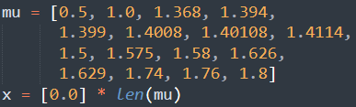

Basic Settings 基本设置
Duplicate ‘single.py’ as ‘simple.py’
将’single.py’复制为’simple.py’
Modify the configuration of parameter $μ$ & initial $x_{0}$ from
将参数$μ$和初始值$x_{0}$的配置从
to
改为

Slide 3

Record Array 记录数组
Modify the storage initialization for the records from
将记录存储空间的初始化从
to
改为

Slide 4
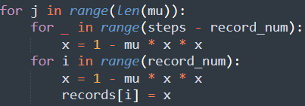
Calculation & Recording
计算与记录 (1)
Put the calculation & recording into an outer loop w/ indent
将计算与记录缩进并放入一个外重循环中

Slide 5
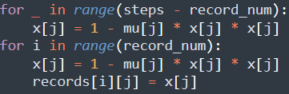
Calculation & Recording
计算与记录 (2)
Add the additional indices to the variables in calculation & recording 在计算和记录时，为变量加入额外的下标

Slide 6

Results 结果
Change the record output from single number per line
将记录输出从一行单个数
to multiple numbers per line
改为一行多个数
Run it 运行之
python simple.py

Slide 7
The End

